Slide 1

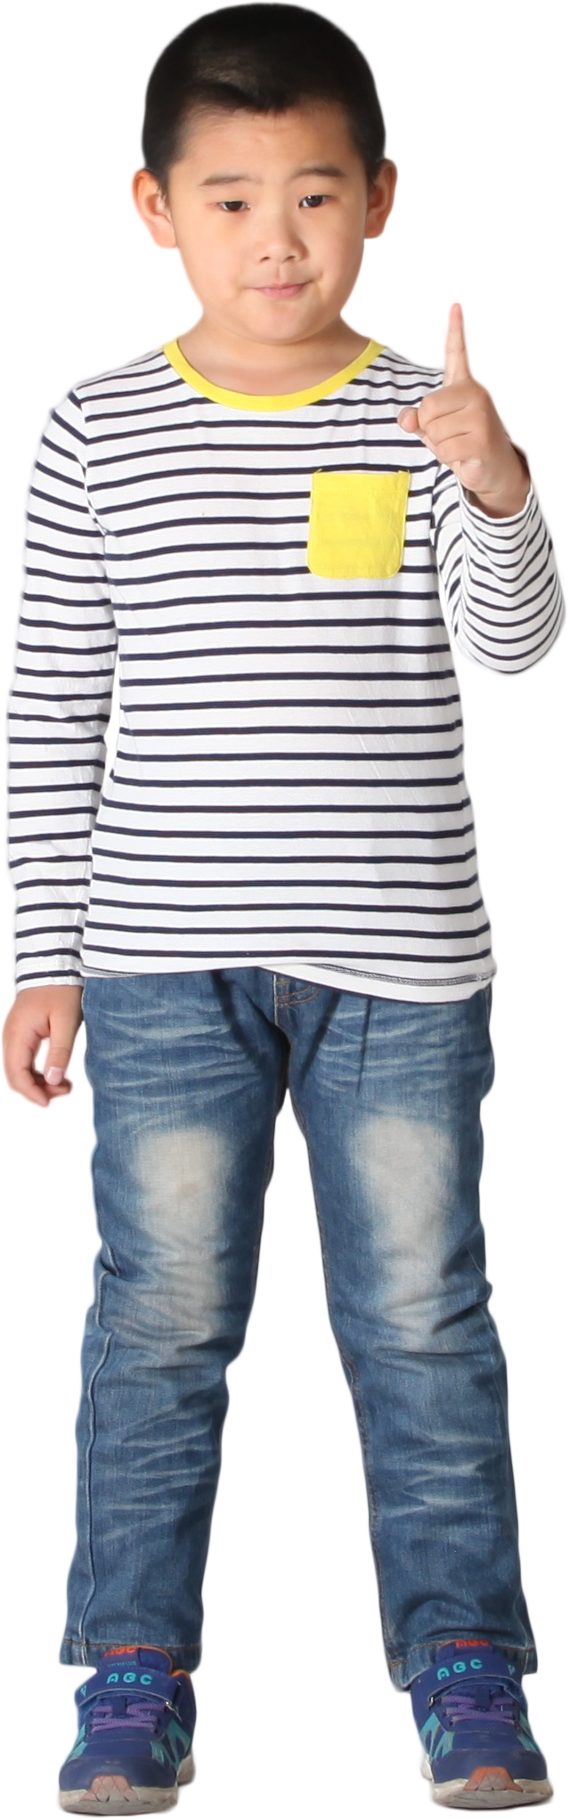


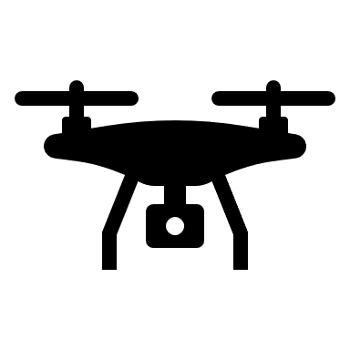
UAV controlled by hand signs
Give instruction with hand signs
Detect hand
Recognize hand sign
Capture images
Send instruction to MQTT server
Receive instruction from computer
Receive instruction from MQTT server
Publish instruction to the subscribers
Execute instruction

